Slide 1
Ankylosing Spondylitis
M Handel
1st Feb 2012

Slide 2
Ankylosing Spondylitis (AS)
AS is a chronic, progressive immune-mediated inflammatory disorder that results in ankylosis of the vertebral column and sacroiliac joints¹
The spine and sacroiliac joints are the common affected sites¹
Chronic spinal inflammation (spondylitis) can lead to fusion of vertebrae (ankylosis)¹
¹ Taurog JD. et al. Harrison‘s Principles of Internal Medicine, 13 th Ed. 1994: 1664-67.

Slide 3
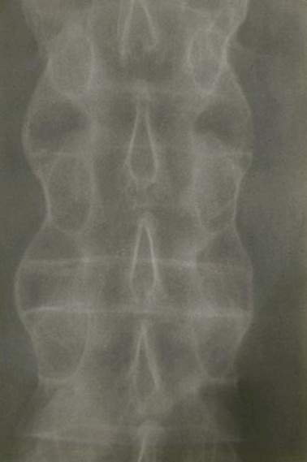
Ankylosing Spondylitis “Bamboo Spine”
Repeated process of healing and bone formation leads to formation of syndesmophytes
‘bone bridges’
ACR Slide Collection on the Rheumatic Diseases; 3rd edition. 1994.
Notes:
Classic Bamboo Spine x-ray of AS, this is the usual fate of patients with spinal involvement in AS.
Syndesmophytes are the bony bridges that form between bones as a consequence of inflammation.

Slide 4
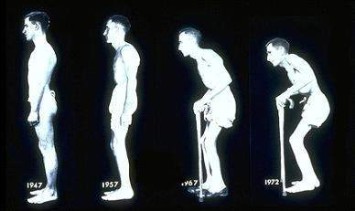
AS: A Debilitating Rheumatic Disease
Over time, joints in the spine can fuse together and cause a fixed, bent-forward posture
AS patients have an important impact on health care and non health-care resource utilization, resulting in a mean total cost (direct and productivity) of about $6700 to $9500/year/patient¹
More than 30% of patients carry a heavy burden of disease and have a decreased QoL²
¹Linden VD et al. Chapter 10. In: Firestein, Budd, Harris, McInnes, Ruddy and Sergent, eds. Kelley’s Textbook of Rheumatology: Spondyloarthropathies. 8th ed. Saunders Elsevier;2009:p.1171
² Braun J & Sieper. J Rheumatology 2008;47:1738-40
Notes:
#### PLEASE DO NOT DELETE CONTENT BELOW THIS LINE ! ####
########### Presentation 'REM_OPT05_AS_r02_02SEP10.ppt' created on Thursday, 2 September, 2010 ###########
Author: GIB1 Purpose: Optimize slide decks QA: 27-Mar-09 Review By: 18-Sep-09
Review Type: Scientific, Reference Check, Compliance Review and HCC Office Slide: 24/168 Golimumab-Specific Deck: No

Slide 5
AS (“Mis-”) Perceptions
0.1-0.9%^{1,2}
“Rare”
“Not” a serious disease, functional limitation is mild
“Rarely shortens life”
Burden of disease significant in pain, sick leave, early retirement^{3,4,5}
Mortality figures parallel RA^{6,7,8}
¹ Sieper J et al. Ann Rheum Dis. 2002; 61 (suppl 3);iii8-18. ² Lawrence RC., Arthritis Rheum 1998; 41:778-99. ³ Zink A., et al., J Rheumatol 2000; 27:613-22.
⁴ Boonen A. Clin Exp Rheumatol. 2002;20(suppl 28):S23-S26.
⁵ Gran JT, et al. Br J Rheumatol. 1997;36:766-771.
⁶ Wolfe F., et al. Arthritis Rheum. 1994 Apr;37(4):481-94.
⁷ Myllykangas-Luosujarvi R, et al. Br J Rheumatol. 1998;37:688-690.
⁸ Khan MA, et al. J Rheumatol. 1981;8:86-90.
⁹ Braun J., Pincus T., Clin Exp Rheumatol. 2002; 20(6 Suppl 28):S16-22.
Notes:
ANIMATED SLIDE (CLICK FOR EACH BULLET POINT)
Perceptions about AS are still wrong today. Physicians diagnose AS late, because they think it is rare, not a serious disease and that patients don’t die as a result of the disease. Patients often seek care late for the same reasons.

Slide 6
Epidemiology of AS
The incidence of AS may be underestimated due to unreported cases¹
HLA-B27 gene is associated with AS⁶
Age of onset typically between 15 and 35 years^{1,2,3}
2-3 times more frequent in men than in women⁶
¹The Spondylitis Association of America. Available at: www.spondylitis.org. Accessed December 2,2004. 61(suppl 3);iii8–18. ⁶Khan MA. Ann Intern Med. 2002;136:896–907.

Slide 7
SpA and HLA-B27
Disease | Approximate Prevalence of HLA-B27 (%)
AS | 90
Reactive arthritis (ReA) | 40-80
Juvenile spondyloarthropathy | 70
Enteropathic spondyloarthropathy | 35-75
Psoriatic arthritis | 40-50
Undifferentiated spondyloarthropathy | 70
Acute anterior uveitis | 50
Aortic incompetence with heart block | 80
Khan MA. Ann Intern Med 2002;136(12):896-907
Notes:
#### PLEASE DO NOT DELETE CONTENT BELOW THIS LINE ! ####
########### Presentation 'REM_OPT05_AS_r02_02SEP10.ppt' created on Thursday, 2 September, 2010 ###########
Author: GIB1 Purpose: Optimize slide decks QA: 27-Mar-09 Review By: 18-Sep-09
Review Type: Scientific, Reference Check, Compliance Review and HCC Office Slide: 9/168 Golimumab-Specific Deck: No

Slide 8
AS: Characteristic Pathologic Features
Chronic inflammation in:
Axial structures (sacroiliac joint, spine, anterior chest wall, shoulder and hip)
Possibly large peripheral joints, mainly at the lower limbs (oligoarthritis)
Entheses (enthesitis)
Bone formation particularly in the axial joints
Inflammation
Disease activity
Structural damage
Syndesmophytes formation
Sieper J. Arthritis Res Ther 2009;11:208
Elewaut D & Matucci MC. Rheumatology 2009;48:1029-1035
Notes:
#### PLEASE DO NOT DELETE CONTENT BELOW THIS LINE ! ####
########### Presentation 'REM_OPT05_AS_r02_02SEP10.ppt' created on Thursday, 2 September, 2010 ###########
Author: GIB1 Purpose: Optimize slide decks QA: 27-Mar-09 Review By: 18-Sep-09
Review Type: Scientific, Reference Check, Compliance Review and HCC Office Slide: 15/168 Golimumab-Specific Deck: No

Slide 9
AS: Signs and Symptoms
Inflammation
Disease activity
Axial manifestations:
Chronic low back pain
With or without buttock pain
Inflammatory characteristics:
Occurs at night (second part)
Sleep disturbance
Morning stiffness
Limited lumbar motion
Onset before age of 40 years
MRI sacro-iliac joint
Inflammatory back pain (IBP) = Characteristic symptom
Sengupta R & Stone MA. Nat Clin Pract Rheumatol 2007;3:496-503
Hultgren S et al. Scand J Rheumatol 2000;29:365-369
Linden VD et al. Chapter 10. In: Firestein, Budd, Harris, McInnes, Ruddy and Sergent, eds. Kelley’s
Textbook of Rheumatology: Spondyloarthropathies. 8th ed. Saunders Elsevier;2009:p.1175
Notes:
Pictures are from the CRI website (http://www.cri-net.com/) and are free for use
IRM des sacro-iliaques – Rehaussement du signal après injection de gadolinium témoignant de l’existence d’une sacro-iliite droite (spondylarthrite ankylosante débutante)
#### PLEASE DO NOT DELETE CONTENT BELOW THIS LINE ! ####
########### Presentation 'REM_OPT05_AS_r02_02SEP10.ppt' created on Thursday, 2 September, 2010 ###########
Author: GIB1 Purpose: Optimize slide decks QA: 27-Mar-09 Review By: 18-Sep-09
Review Type: Scientific, Reference Check, Compliance Review and HCC Office Slide: 16/168 Golimumab-Specific Deck: No

Slide 10
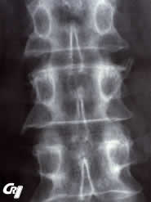
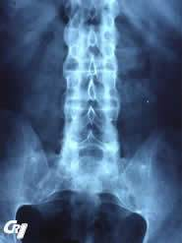
AS: Structural Damage
Structural damage
Syndesmophytes formation
Most striking feature of AS = New bone formation in the spine with:
Spinal syndesmophytes
Ankylosis
Both can be seen on conventional radiography
X-ray showing syndesmophytes
Even in patients with longer-standing disease, syndesmophytes are present in ～50% patients and a smaller percentage will develop ankylosis
Bamboo spine and bilateral sacroiliitis
Sieper J. Arthritis Res Ther 2009;11:208
Notes:
#### PLEASE DO NOT DELETE CONTENT BELOW THIS LINE ! ####
########### Presentation 'REM_OPT05_AS_r02_02SEP10.ppt' created on Thursday, 2 September, 2010 ###########
Author: GIB1 Purpose: Optimize slide decks QA: 27-Mar-09 Review By: 18-Sep-09
Review Type: Scientific, Reference Check, Compliance Review and HCC Office Slide: 17/168 Golimumab-Specific Deck: No

Slide 11
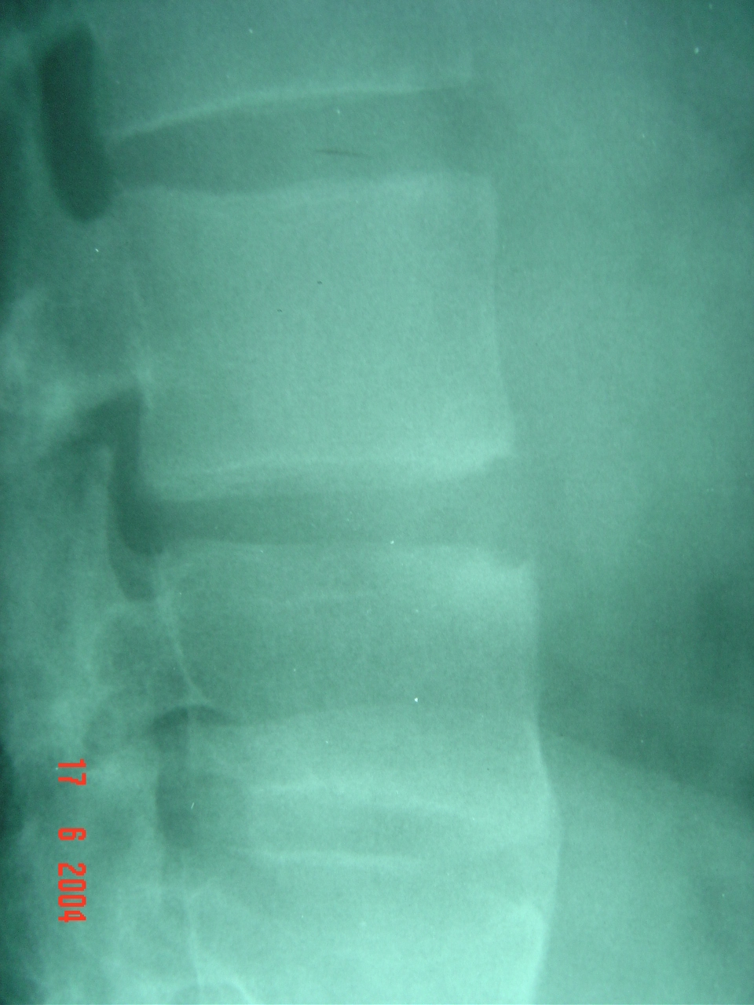
Marginal erosions and new bone formation

Slide 12
Unilateral sacroiliitis

Slide 13
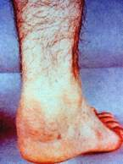
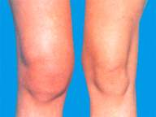
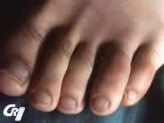
AS: Signs and Symptoms
Peripheral manifestations
Enthesitis
Peripheral arthritis
Dactylitis
50% patients with enthesitis¹
Up to 58% patients ever had arthritis¹
Much smaller number of patients²
¹Cruyssen BV et al. Ann Rheum Dis 2007;66:1072-1077
²Sidiropoulos PI et al. Rheumatology 2008;47:355-361
Notes:
2 first Pictures come from following website: http://www.rheumatologie-berlin.de/probability/early.php?m_id=9&s_id=91, the third one from the CRI website (http://www.cri-net.com/)
#### PLEASE DO NOT DELETE CONTENT BELOW THIS LINE ! ####
########### Presentation 'REM_OPT05_AS_r02_02SEP10.ppt' created on Thursday, 2 September, 2010 ###########
Author: GIB1 Purpose: Optimize slide decks QA: 27-Mar-09 Review By: 18-Sep-09
Review Type: Scientific, Reference Check, Compliance Review and HCC Office Slide: 19/168 Golimumab-Specific Deck: No

Slide 14
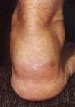
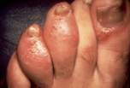
Why are Dactylitis and Enthesitis Important?
Likelihood of erosions is higher for digits with dactylitis than those without¹
The first abnormality to appear in swollen joints associated with spondyloarthropathies is an enthesitis²
¹Brockbank. Ann Rheum Dis 2005;62:188-90;
²McGonagle et al. The Lancet 1998;352.
Notes:
14
Dactylitis=painfull swelling of the whole digit caused by inflammation

Slide 15
AS: Extra-skeletal Signs and Symptoms
Other common symptoms seen during the early stages of disease include:
Anorexia
Malaise
Low grade fever
Weight loss
Fatigue
Fatigue is a frequent complaint of patients with AS¹
¹Missaoui B. et al. Ann Readapt Med Phys 2006;49:305-8, 389-391
Linden VD et al. Chapter 10. In: Firestein, Budd, Harris, McInnes, Ruddy and Sergent, eds. Kelley’s Textbook of Rheumatology: Spondyloarthropathies. 8th ed. Saunders Elsevier;2009:p.1176
Notes:
#### PLEASE DO NOT DELETE CONTENT BELOW THIS LINE ! ####
########### Presentation 'REM_OPT05_AS_r02_02SEP10.ppt' created on Thursday, 2 September, 2010 ###########
Author: GIB1 Purpose: Optimize slide decks QA: 27-Mar-09 Review By: 18-Sep-09
Review Type: Scientific, Reference Check, Compliance Review and HCC Office Slide: 21/168 Golimumab-Specific Deck: No

Slide 16
AS: Extra-articular Manifestations (EAM)
EAM | Prevalence in AS Patients (%)
Anterior uveitis | 30-50
IBD | 5-10
Subclinical inflammation of the gut | 25-49
Cardiac abnormalities Conduction disturbances Aortic insufficiency | 1-33 1-10
Psoriasis | 10-20
Renal abnormalities | 10-35
Lung abnormalities Airways disease Interstitial abnormalities Emphysema | 40-88 82 47-65 9-35
Bone abnormalities Osteoporosis Osteopenia | 11-18 39-59
Anterior uveitis
Terminal ileitis
Cardiac
abnormalities
Elewaut D & Matucci MC. Rheumatology 2009;48:1029-1035
Notes:
Pictures from the CRI website (http://www.cri-net.com/)
#### PLEASE DO NOT DELETE CONTENT BELOW THIS LINE ! ####
########### Presentation 'REM_OPT05_AS_r02_02SEP10.ppt' created on Thursday, 2 September, 2010 ###########
Author: GIB1 Purpose: Optimize slide decks QA: 27-Mar-09 Review By: 18-Sep-09
Review Type: Scientific, Reference Check, Compliance Review and HCC Office Slide: 22/168 Golimumab-Specific Deck: No

Slide 17
Ankylosing Spondylitis
Classification

Slide 18
Diagnosis of AS
Modified New York Criteria for AS¹
Low back pain > 3 months (improved by exercise and not relieved by rest)
Limitation of lumbar spinal motion in sagittal and frontal planes
Chest expansion decreased relative to normal
Bilateral sacroilitis grade 2-4 or unilateral sacroilitis grade 3 or 4
Detection of sacroilitis via X-ray or MRI¹
MRI can be used for earlier detection of inflammation (enthesitis) at other sites.
There is no specific laboratory test for AS¹
ESR and CRP can indicate inflammation
50-70% of active AS patients will have increased ESR and CRP²
Rheumatoid factor is not associated with AS
HLA-B27
¹Khan M, Ankylosing Spondylitis-the facts; 2002:Oxford University Press:94-98. ²Sieper J, et al. Ann Rheum Dis. 2002;61(Suppl 8).

Slide 19
Diagnostic Standard for AS: Modified NY Classification Criteria (1984)¹
Clinical components:
Low back pain and stiffness for more than 3 months which improves with exercise, but is not relieved by rest
Limitation of motion of the lumbar spine in both the sagittal and frontal planes
Limitation of chest expansion relative to normal values correlated for age and sex
Radiological component:
Sacroiliitis Grade >2 bilaterally or Grade 3-4 unilaterally
Old criteria
Defined before TNF blockers
Sacroiliitis detectable by X-ray occurs lately
No magnetic resonance imaging (MRI)
Used for clinical trial
Definite AS if the radiological criterion is associated with at least one clinical criterion²
Probable AS if three clinical criteria present or radiologic criteria present without clinical criteria²
¹Linden VD et al. Arthritis Rheum 1984;27:361-368
²Rudwaleit M et al. Arthritis Rheum 2005;52:1000-1008
Notes:
#### PLEASE DO NOT DELETE CONTENT BELOW THIS LINE ! ####
########### Presentation 'REM_OPT05_AS_r02_02SEP10.ppt' created on Thursday, 2 September, 2010 ###########
Author: GIB1 Purpose: Optimize slide decks QA: 27-Mar-09 Review By: 18-Sep-09
Review Type: Scientific, Reference Check, Compliance Review and HCC Office Slide: 30/168 Golimumab-Specific Deck: No

Slide 20
Diagnostic Standard for AS: Modified NY Classification Criteria (1984) (Cont’d)
Radiographic stage
(Ankylosing Spondylitis)
Back Pain Radiographic sacroiliitis
Back Pain Syndesmophytes
Modified NY criteria (1984)
Time (years)
The greatest problem in the management of AS was the lack of effective treatments. In recent years, NSAIDs and TNF-blockers have been shown to have good efficacy in the treatment of AS.
Adapted from Rudwaleit M et al. Arthritis Rheum 2005;52:1000-1008
Brandt HC et al. Ann Rheum Dis 2007;66:1479-84
Notes:
#### PLEASE DO NOT DELETE CONTENT BELOW THIS LINE ! ####
########### Presentation 'REM_OPT05_AS_r02_02SEP10.ppt' created on Thursday, 2 September, 2010 ###########
Author: GIB1 Purpose: Optimize slide decks QA: 27-Mar-09 Review By: 18-Sep-09
Review Type: Scientific, Reference Check, Compliance Review and HCC Office Slide: 31/168 Golimumab-Specific Deck: No

Slide 21
Diagnostic Standard for AS: Modified NY Classification Criteria (1984) (Cont’d)
Pre-radiographic stage (Axial undifferentiated SpA)
Radiographic stage
(Ankylosing Spondylitis)
Back Pain IBP
MRI active sacroiliitis
Back Pain Radiographic sacroiliitis
Back Pain Syndesmophytes
Modified NY criteria (1984)
Time (years)
Recent application of MRI techniques has demonstrated (and confirmed) that ongoing active (“acute”) inflammation in fact does occur in the sacroiliac joints and/or spine prior to the appearance of changes detectable radiographically
The presence and absence of radiographic sacroiliitis in patients with SpA represent different stages of a single disease continuum
Adapted from Rudwaleit M et al. Arthritis Rheum 2005;52:1000-1008
Notes:
#### PLEASE DO NOT DELETE CONTENT BELOW THIS LINE ! ####
########### Presentation 'REM_OPT05_AS_r02_02SEP10.ppt' created on Thursday, 2 September, 2010 ###########
Author: GIB1 Purpose: Optimize slide decks QA: 27-Mar-09 Review By: 18-Sep-09
Review Type: Scientific, Reference Check, Compliance Review and HCC Office Slide: 31/168 Golimumab-Specific Deck: No

Slide 22
Spondyloarthritis and Classification Criteria
Spondyloarthropathies
Axial and Peripheral
AMOR criteria (1990)
ESSG criteria (1991)
Axial Spondyloarthritis
ASAS classification 2009
Peripheral Spondyloarthritis
ASAS classification 2010
Ankylosing spondylitis
Prototype of axial spondylitidis
Modified New York criteria 1984
Infliximab (IFX) and Golimumab (GLM)
indications
Psoriatic arthritis
From Moll & Wright 1973 to CASPAR criteria 2006
ESSG: European Spondyloarthropathy Study Group
ASAS: Assessment of Spondyloarthritis International Society
CASPAR: Classification criteria for psoriatic arthritis
Sieper et al. Ann Rheum Dis 2009;68:ii1-ii44
Taylor et al. Arthritis & Rheum 2006;54:2665-73
Van der Heijde et al. Ann Rheum Dis 2011;70:905-8
Notes:
#### PLEASE DO NOT DELETE CONTENT BELOW THIS LINE ! ####
########### Presentation 'GLM_OPT02_GLM Optimize PsA_r00_05AUG10.ppt' created on Wednesday, 4 August, 2010 ###########
Author: GIB1 Purpose: Optimize slide decks QA: 04-Aug-10 Review By: 04-Feb-11
Review Type: Scientific, Reference Check, Compliance Review and HCC Office Slide: 15/108 Golimumab-Specific Deck: Yes

Slide 23
ASAS Classification Criteria for Axial SpA
In patients with back pain ≥3 months and age at onset <45 years
Sacroiliitis* on imaging
plus
≥1SpA feature**
HLA-B27
plus
≥2 other SpA features**
OR
*Sacroiliitis on imaging:
Active (acute) inflammation on MRI highly suggestive of sacroiliitis associated with SpA
or
Definite radiographic sacroiliitis according to modified New York criteria
**SpA features:
Inflammatory back pain
Arthritis
Enthesitis (heel)
Uveitis
Dactylitis
Psoriasis
Crohn’s disease/ulcerative colitis
Good response to NSAIDs
Family history for SpA
HLA-B27
Elevated CRP
Rudwaleit M et al. Ann Rheum Dis 2009;68(6):770-6
Notes:
Sensitivity 82.9%, specificity 84.4%; n=649 patients with chronic back pain and age at onset <45 yrs.
Imaging arm (sacroiliitis) alone has a sensitivity of 66.2% and a specificity of 97.3%. ** Note: Elevated CRP is considered
a SpA feature in the context of chronic back pain
#### PLEASE DO NOT DELETE CONTENT BELOW THIS LINE ! ####
########### Presentation 'REM_OPT05_AS_r02_02SEP10.ppt' created on Thursday, 2 September, 2010 ###########
Author: GIB1 Purpose: Optimize slide decks QA: 27-Mar-09 Review By: 18-Sep-09
Review Type: Scientific, Reference Check, Compliance Review and HCC Office Slide: 101/168 Golimumab-Specific Deck: No

Slide 24
Ankylosing Spondylitis
Response Criteria

Slide 25
ASAS Working Group Criteria for Response
Patients will be categorized as an ASAS 20 responder if the patient achieves the following:
>20% improvement from baseline and absolute baseline improvement of >10 (on a 0-100mm scale) in at least 3 of the following 4 domains:
Patient global assessment
Spinal pain
Function (BASFI)
Inflammation
Average of the last 2 BASDAI questions concerning level and duration of morning stiffness
No deterioration from baseline (>20% and absolute change of at least 10 on a 0-100 mm scale) in the potential remaining domain
Anderson JJ, et al. Arthritis Rheum. 2001;44(8):1876–1886.
Notes:
Since the BASDAI and BASFI alone do not give a complete disease measurement assessment of the AS patient, the ASAS response criteria was developed. In essence, this combines aspects of the BASDAI and BASFI into one criteria.
ABSTRACT from A&R article follows:
Objective. To develop criteria for symptomatic improvement in patients with ankylosing spondylitis (AS), using outcome domain data from placebo controlled clinical trials of nonsteroidal anti-inflammatory drugs (NSAIDs).
Methods. Patient data from 5 short-term, randomized, controlled trials were used to assess equivalence, reliability, and responsiveness of multiple items in the 5 outcome domains for AS treatment: physical function, pain, spinal mobility, patient global assessment, and inflammation. At least one measure per domain was responsive (standardized response mean of >0.5), except for the spinal mobility domain, which was omitted from the criteria. We developed and tested candidate improvement criteria in a random two-thirds subset from the 3 largest trials and used the remaining one-third for validation. These 3 largest trials included 923 patients (631 receiving NSAIDs, 292 in placebo groups). We selected the multiple domain definition that best distinguished NSAID treatment from placebo by chi-square test and that had a placebo response rate of <25%. Results. Candidate definitions were changes in single domains and in multiple measure indices, as well as combinations of improvements in multiple domains. Worsening in a domain was defined as a change for the worse of >20% and a net change for the worse of >10 units on a scale of 0–100. Partial remission (for comparison purposes) was defined as an end-of-trial value of <20/100 in each of the 4 domains. Among 20 candidate criteria, change of >20% and >10 units in each of 3 domains and absence of worsening in the fourth discriminated best in the development subset (51% of patients improved with NSAIDs, 25% with placebo; x2 5 36.4, P < 0.001). Results were confirmed in the validation subset. Almost all patients satisfying the definition of partial disease remission at the end of the trial had also improved by this criterion. Among all 923 patients, improvement rates using this criterion were 49% for NSAID-treated patients and 24% for placebo-treated patients. Conclusion. Although further validation using data from new trials is still needed, we conclude that we have developed a clinically valid, easy-to-use measure of short-term improvement in AS.

Slide 26
Bath Ankylosing Spondylitis Disease Activity Index (BASDAI)
The BASDAI is measured using the following VAS (0 to 10 cm) of subject self-assessments:
Fatigue
Spinal pain
Joint pain
Enthesitis
Inflammation
Duration morning stiffness
Severity morning stiffness
Garrett S, et al. J Rheumatol. 1994;21:2286–2291.
Notes:
THE BATH AS DISEASE ACTIVITY INDEX (BASDAI) - Garrett et al, 1994
The research team identified that no gold standard was available for measuring disease activity in AS. The authors acknowledged research, from the Royal National Hospital for the Rheumatic diseases, that identified fatigue as a major component of AS. It was therefore suggested that this should be incorporated into measures of disease activity. The BASDAI was subsequently developed. As with the functional index, the research team included major input from patients with AS, to enhance clinical relevance and disease specifity. Like the BASFI, the BASDAI consists of 10cm visual analog scales used to answer 6 questions pertaining to the 5 major symptoms of AS: 1.) Fatigue 2.) Spinal pain 3.) Joint pain / swelling 4.) Areas of localized tenderness 5.) Morning stiffness.
To give each symptom equal weighting, the mean of the two scores relating to morning stiffness is taken. The resulting 0 to 50 score is divided by 5 to give a final 0 – 10 BASDAI score (refer to page 12). When clinically tested, results showed: 1) BASDAI to be a quick and simple index (taking between 30 secs and 2 mins to complete) 2) BASDAI demonstrated statistically significant (p<0.001) reliability. 3) The individual symptoms and the index as a whole demonstrated good score distribution, using 95% of the scale. 4) Following a 3 week physiotherapy course, the BASDAI showed a significant (p=0.009) 16.4% score improvement, therefore demonstrating a sensitivity to change.
By comparison, a previous disease activity index did demonstrate greater sensitivity to change (22.8% improvement being shown). However, the authors recognized that the previous index had a bias towards pain and included a scale measuring patient’s sense of well being. It is felt that the BASDAI is superior in terms of symptoms considered and their weighting. This may be due to the input from patients with AS when the index was developed. The BASDAI was also found to be superior in all aspects to the Newcastle Enthesis index.Calin et al (1999) have further assessed the validity of the BASDAI. With a sample size of 473, a double-blind, placebo-controlled study of 6 weeks duration was conducted. Subjects were divided into two groups. One group received a placebo. The other group received an active NSAID. Disease activity was assessed with the BASDAI and by analyzing a wide range of individual symptom components. The authors concluded that BASDAI has excellent content validity.
To conclude, the BASDAI is user friendly, highly reliable, reflects the entire spectrum of the disease, and is sensitive to clinical changes (Garrett et al, 1994).

